Slide 1
Reverse Proxy

Slide 2
HTTP

Slide 3
HTTP Overview
HTML
Java applet
Objects
JPEG
Audio

Slide 4


HTTP Overview
HTTP Request
HTTP Response
HTTP uses TCP as underlying protocol
⇒ Client initiate TCP connection & server accepts it
Creates socket
HTTP is stateless
⇒ How web pages keeps our states then?
like staying login after closing the page → cookies

Slide 5
HTTP connections
HTTP
non-persistent
persistent
At most one object sent over TCP connection
Then the connection closes
Getting multiple objects, required multiple TCP connection
Multiple objects can be sent over a single TCP connection

Slide 6
Non-persistent HTTP
Consider a URL containing references to 5 objects: www.example.com/someURI/someindex.index
1.a: Client initiate TCP connection to www.example.com on port 80
1.b: Server which is waiting for TCP connection on port 80, accepts it and notify the client
2: Client sends HTTP request message over TCP socket indicating that client wants /someURI/someindex.index
3: Server receives request message and forms response message containing requested object and send it into socket
Time
5: Client receives response message containing html file and displays it. Parsing html file, shows references to 5 objects needed
4: Server closes TCP connection
6: Client repeats 1-5 steps for 5 objects

Slide 7
Non-persistent HTTP response time
Initiate TCP connection
Definition of RTT: time for a small packet to travel from client to server & back
RTT
Request file
RTT
Time to transmit file
Receive file
Response Time:
1 RTT for TCP connection
1 RTT for HTTP request
A little time to transmit file
Time
Time
Non-persistent HTTP response time = 2*RTT + file transmission time

Slide 8
Persistent HTTP
index.html
Non-persistent issues:
Requires 2 RTTs per object
OS overhead for each TCP connection
Browsers often open parallel TCP connections to fetch referenced objects
1st object
2nd object
How to resolve non-persistent issues:
Server leave the connection open after sending response for a specific time
Subsequent HTTP messages send over same connection
Client sends requests as soon as it encounters a referenced object
Reduce response time to as little s 1 RTT for all referenced objects
.
.
.
nth object

Slide 9
Persistent HTTP
index.html
Non-persistent issues:
Requires 2 RTTs per object
OS overhead for each TCP connection
Browsers often open parallel TCP connections to fetch referenced objects
Send request for all required objects
Receiving response for all required objects
Some sort of timeout
How to resolve non-persistent issues:
Server leave the connection open after sending response for a specific time
Subsequent HTTP messages send over same connection
Client sends requests as soon as it encounters a referenced object
Reduce response time to as little s 1 RTT for all referenced objects
Close TCP connection
Notes:
For receiving arrows, I intentionally remove the bulky section and replace it with simple arrow to create the diagram more clean but the concept remain the same as before.

Slide 10
HTTP request message
Let’s get back to our example: www.example.com/someURI/someindex.index
Request line (GET, POST, … commands)
GET /someURI/someindex.index HTTP/1.1\r\n
Host: www.example.com\r\n
User-Agent: Firefox/3.6.10\r\n
Accept: text/html,application/xhtml+xml\r\n
Accept-Language: en-us,en;q=0.5\r\n
Accept-Encoding: gzip,deflate\r\n
Accept-Charset: ISO-8859-1,utf-8;q=0.7\r\n
Keep-Alive: 115\r\n
Connection: keep-alive\r\n
\r\n
Carriage return character
Line-feed character
Header lines
Carriage return, line-feed at start of line indicates end of header lines

Slide 11
HTTP request message
GET /someURI/someindex.index HTTP/1.1\r\n
Host: www.example.com\r\n
User-Agent: Firefox/3.6.10\r\n
Accept: text/html,application/xhtml+xml\r\n
Accept-Language: en-us,en;q=0.5\r\n
Accept-Encoding: gzip,deflate\r\n
Accept-Charset: ISO-8859-1,utf-8;q=0.7\r\n
Keep-Alive: 115\r\n
Connection: keep-alive\r\n
\r\n
method | sp | URL | sp | version | cr | lf
request line
header field name |  | value | cr | lf
header field name |  | value | cr | lf
header lines
cr | lf
entity body
Question: Is body really necessary? If yes, when?
body

Slide 12
Request method types
HTTP/0.9:
GET
HTTP/1.0:
GET
POST
HEAD
HTTP/1.1:
GET, POST, HEAD
PUT
PATCH
DELETE
CONNECT
TRACE
OPTIONS
Version 2.0 & 3.0 exists as well

Slide 13
Most useful methods
GET
Get something from server
POST
Get something from server
WHAT?
Let’s back to the question that we ask few slides ago
GET
Required input is uploaded in URL
POST
Required input is uploaded in body
Question: Is body really necessary? If yes, when?
Firefox definition
GET
The GET method requests a representation of the specified resource. Requests using GET should only retrieve data.
POST
The POST method submits an entity to the specified resource, often causing a change in state or side effects on the server.

Slide 14
Most useful methods
HEAD
Exactly like GET method but response has no body
PUT
Uploads file to specified path in URL
DELETE
Deletes file from specified path in URL

Slide 15
HTTP response message
Status line (protocol status code & status phrase
HTTP/1.1 200 OK\r\n
Date: Sun, 26 Sep 2010 20:09:20 GMT\r\n
Server: Apache/2.0.52 (CentOS)\r\n
Last-Modified: Tue, 30 Oct 2022 17:00:02 GMT\r\n
ETag: "17dc6-a5c-bf716880"\r\n
Accept-Ranges: bytes\r\n
Content-Length: 2652\r\n
Keep-Alive: timeout=10, max=100\r\n
Connection: Keep-Alive\r\n
Content-Type: text/html; charset=ISO-8859-1\r\n
\r\n
data data data data data ...
Cache uses this
Header lines
Requested data

Slide 16
HTTP response status codes
1xx: informational response
the request was received, continuing process
2xx: successful
the request was successfully received, understood, and accepted
3xx: redirection
further action needs to be taken in order to complete the request
4xx: client error
the request contains bad syntax or cannot be fulfilled
5xx: server error
the server failed to fulfil an apparently valid request
3xx: Go away
2xx: Here you go
4xx: You fucked up
1xx: Hold on
Let’s get our hand dirty
5xx: I Fucked up
Notes:
Check some requests on app.snapp-box.com

Slide 17




Web caches
It’s clients lawyer to represent them in the Internet
a.k.a. Proxy server
User access web servers through cache server
Browser sends all requests to cache server
Object present in cache server
Cache returns the object
Object missing from cache server
Cache server request it from origin server
save it
return it to client
Client 1
Origin Server
Proxy Server
HEAD
a.k.a. forward proxy
Client 2
Check “Last-Modified” header
Notes:
For any GET request that client makes, proxy server will send a HEAD request to check the “Last-Modified” header

Slide 18
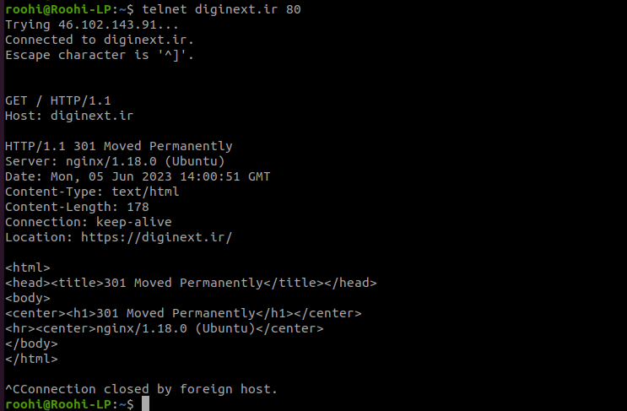
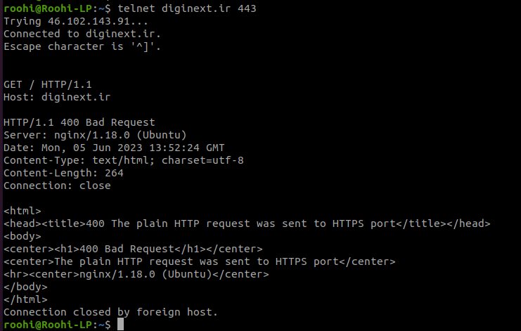
A little fun
telnet diginext.ir 80
telnet diginext.ir 443
Telnet can NOT handle SSL → Why?

Slide 19
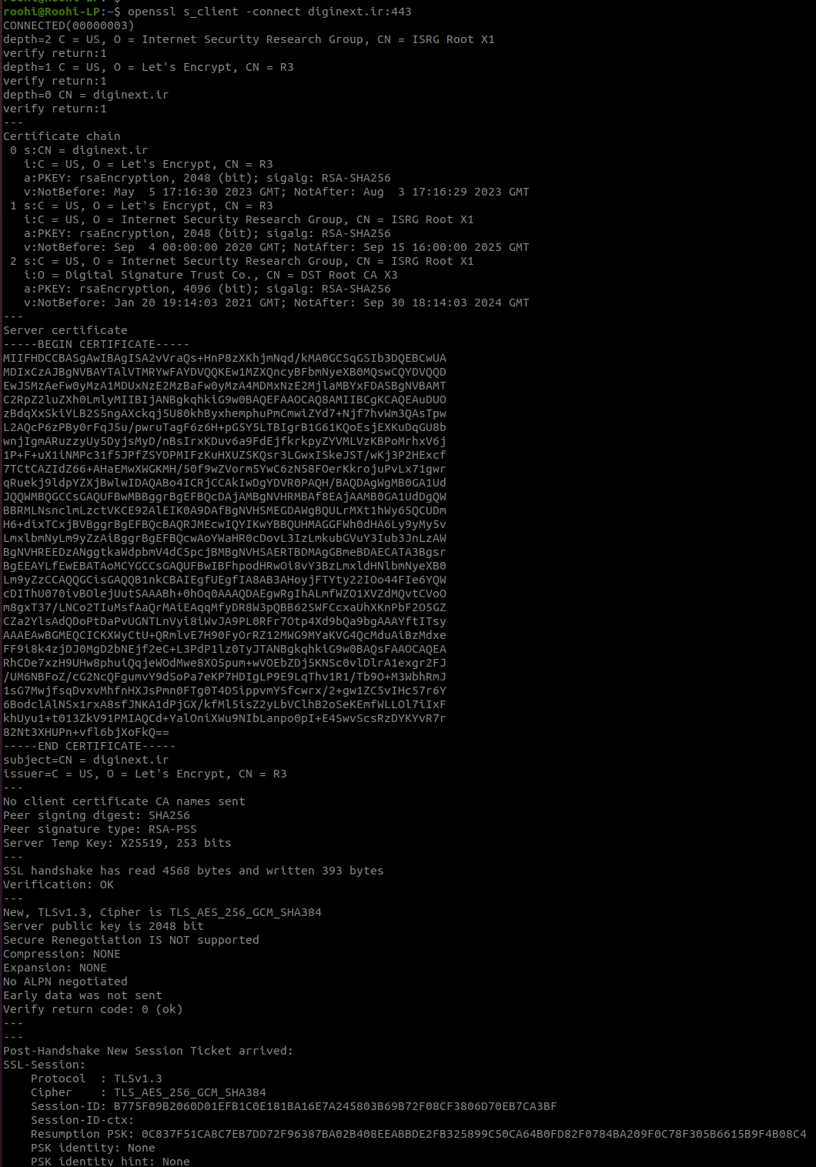
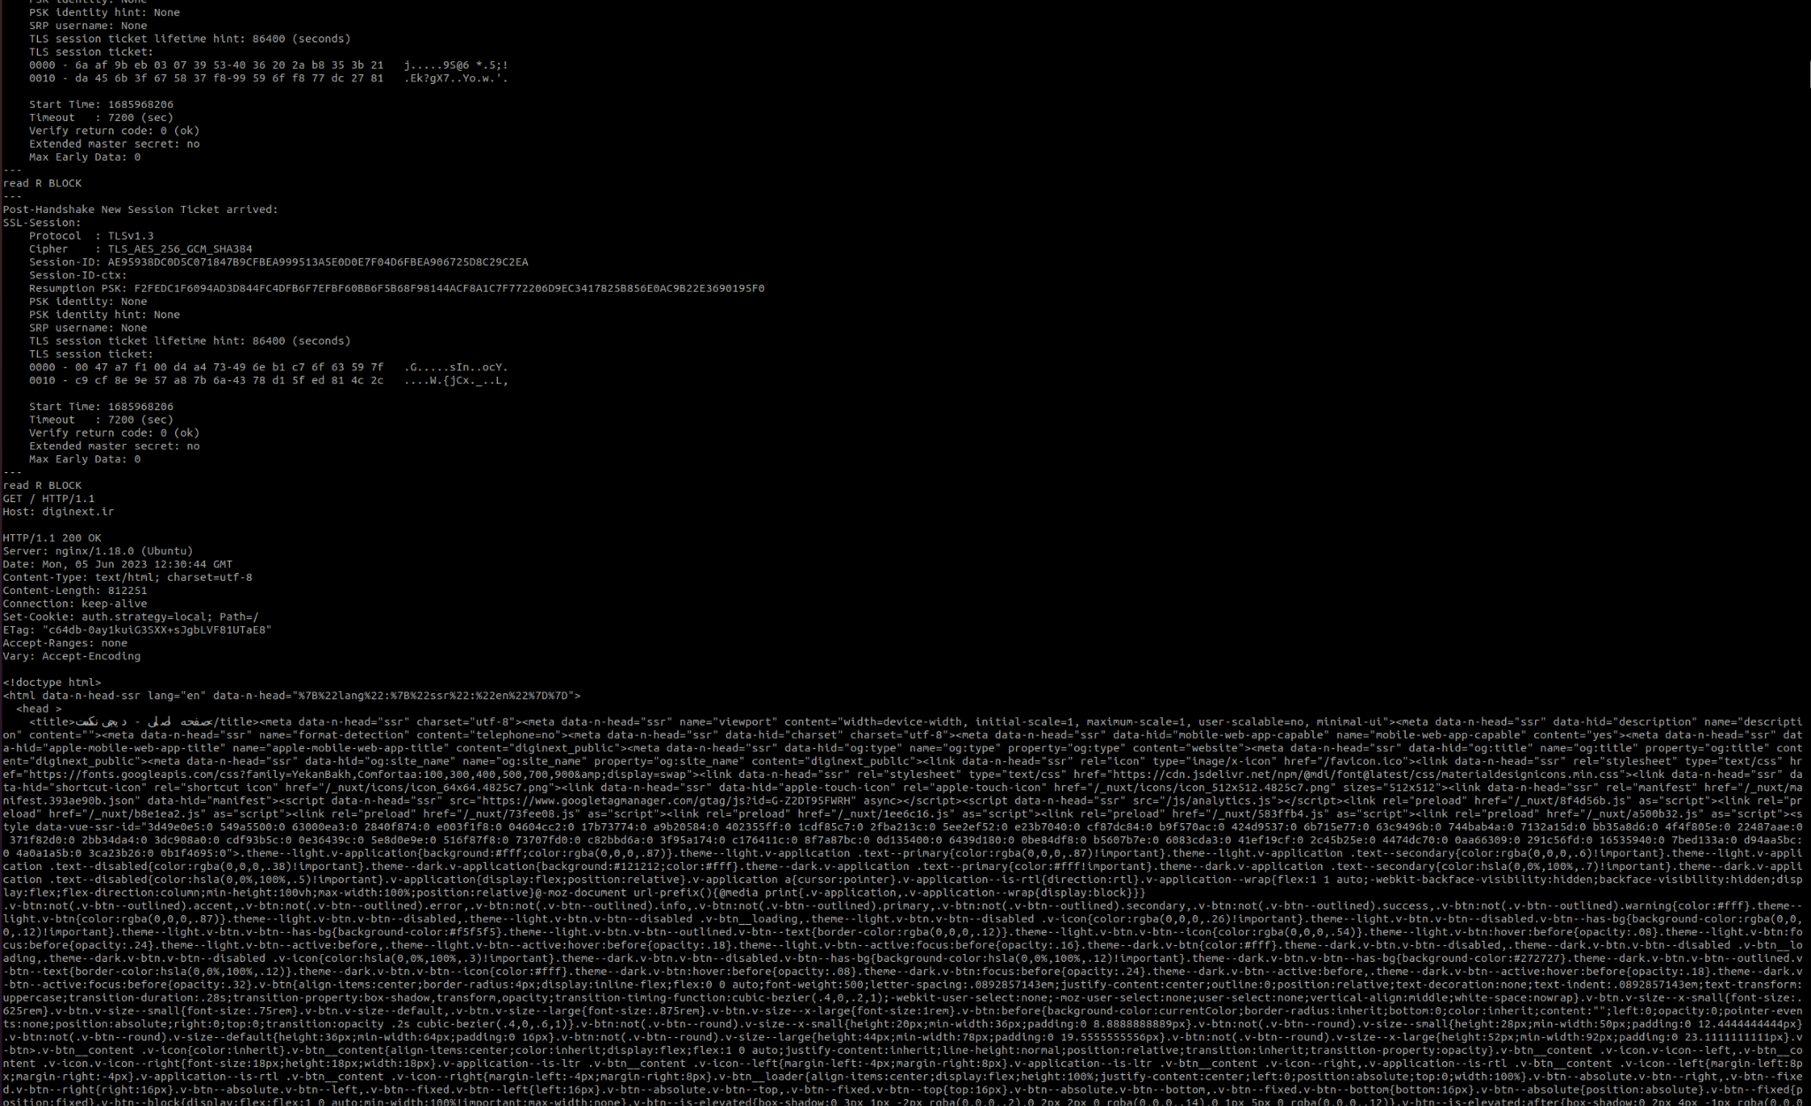
A little fun
openssl s_client -connect diginext.ir:443

Slide 20
Reverse Proxy

Slide 21
What is Reverse Proxy
Private Network
webapp1.example.com
WebApp 1
Internet
webapp2.example.com
Client
Reverse Proxy
WebApp 2
.
.
.
Based on HTTP headers & URL
webappn.example.com
WebApp n
Notes:
Software-Oriented Architecture
Micro Service

Slide 22
Other important functions
Load balancing
Multiple servers may exists for specific WebAPP
Web acceleration
Compress
Caching
SSL offloading
Security
Protect the WebApp identity
Implement some of the security measures like rate limit
SSL offloading

Slide 23
Services
Nginx
HAproxy
Varnish
Squid
Traefik
Pound
Caddy
May also has other functionality as well; like:
Web server
Forward proxy
…

Slide 24
HAproxy
HAproxy is:
a TCP proxy
an HTTP reverse-proxy
an SSL terminator / initiator / offloader
a TCP normalizer
an HTTP normalizer
an HTTP fixing tool
a content-based switch
a server load balancer
a traffic regulator
a protection against DDoS and service abuse
an observation point for network troubleshooting
an HTTP compression offloader
a caching proxy
a FastCGI gateway
HAproxy is NOT:
an explicit HTTP proxy (forward proxy)
a data scrubber
a static web server
a packet-based load balancer
Notes:
TCP normalizer: most important one → prevent SYN flood
HTTP fixing tool: manipulate header
content-based switch: decide based on request regardless of port
data scrubber: do not check or modify body

Slide 25
Essential Sections of HAProxy Configuration
global
Obviously contains global configuration
log
user & group
supported encryptions
…
defaults
Obviously contains default configuration
This is where you put all expected behaviour of all other components
You can override these as you want in their own section
frontend
This is where you can configure something to accept client requests
backend
Servers that fulfil the requests
listen
This is where you can have both functionality of frontend & backend in one section

Slide 26
Essential Sections of HAProxy Configuration
THIS IS A MUST READ MATERIAL:
The Four Essential Sections of an HAProxy Configuration

Slide 27
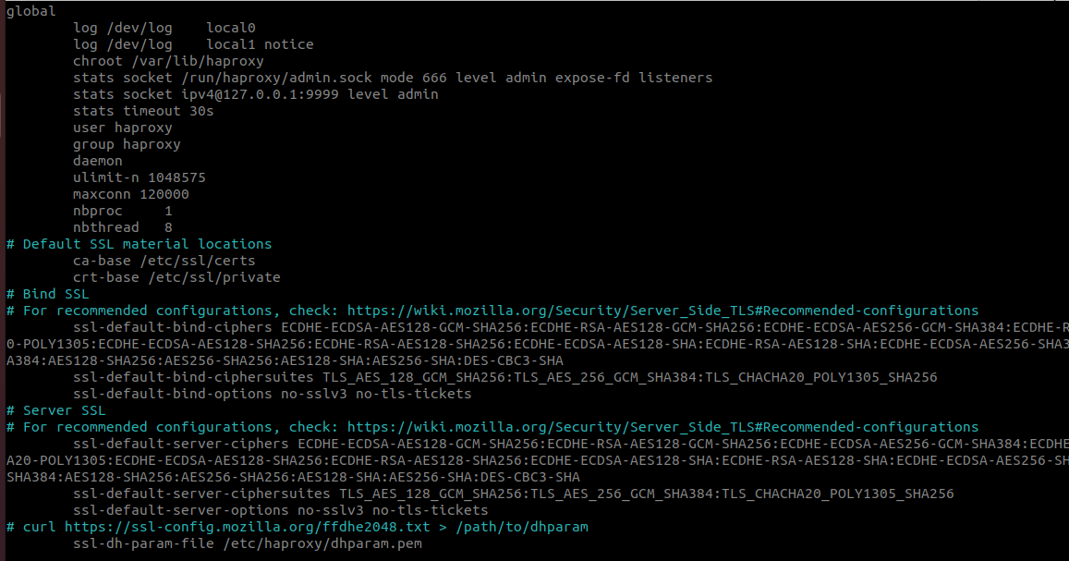
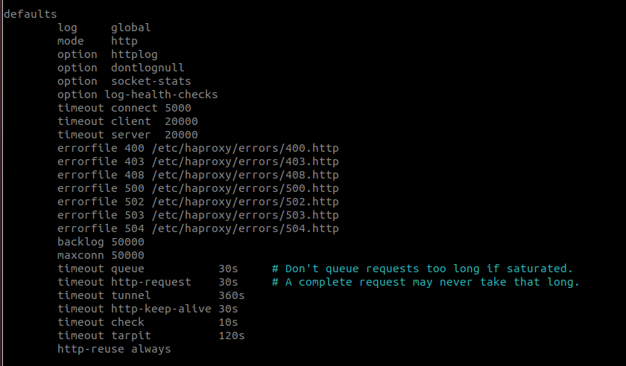
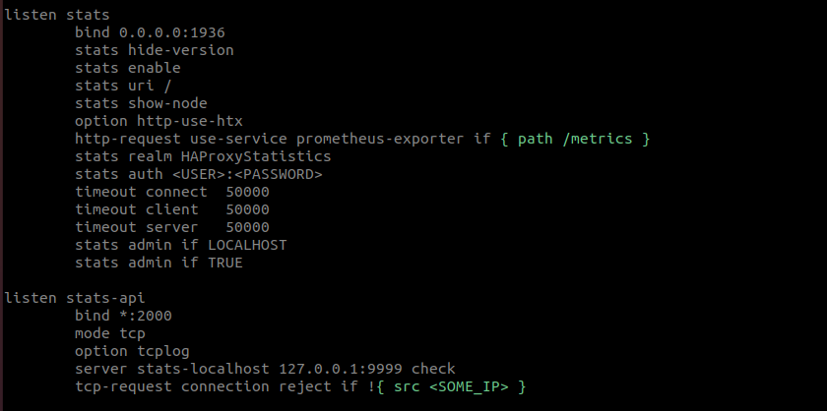
Let’s see some configuration

Slide 28
Let’s see some configuration: frontend
frontend web
#bind <SOME_IP>:<SOME_PORT>
bind *:80
bind *:443 ssl crt /etc/haproxy/ssl/
…
http-request capture req.hdr(host) len 300
http-request capture req.hdr(X-Forwarded-For) len 15
http-request add-header X-Forwarded-Port %[dst_port]
http-request redirect prefix https://owncloud.snpb.app code 301 if { hdr(host) -i learning.snpb.app }
…

Slide 29
Let’s see some configuration: frontend
frontend web
…
acl is_blacklist_ip src -f /etc/haproxy/blacklist.ips
http-request deny deny_status 429 if is_blacklist_ip
acl is_whitelist src -f /etc/haproxy/whitelist.lst
acl is_ok_from_all_ips hdr(host) -i snpb.link
http-request deny if !is_whitelist !is_ok_from_all_ips
…

Slide 30
Let’s see some configuration: frontend
frontend web
…
acl is_k8s_prod_customer-panel hdr(host) -i cpanel.snapp-box.com
acl is_k8s_prod_customer-panel hdr(host) -i app.snapp-box.com
acl is_k8s_prod_customer-panel hdr(host) -i app.snpb.cloud
acl is_k8s_prod_customer-panel hdr(host) -i cpanel.snapp-box.ir
acl is_k8s_prod_customer-panel hdr(host) -i app.snapp-box.ir
acl is_k8s_prod_customer-panel hdr(host) -i app.snpb.ir
…

Slide 31
Let’s see some configuration: frontend
frontend web
…
acl is_k8s_prod_customer-panel hdr(host) -i cpanel.snapp-box.com app.snapp-box.com app.snpb.cloud cpanel.snapp-box.ir app.snapp-box.ir app.snpb.ir
acl is_landing path_beg -i /landing
…

Slide 32
Let’s see some configuration: frontend
frontend web
…
use_backend bk_k8s_prod_customer-panel if is_k8s_prod_customer-panel
use_backend bk_landing if is_k8s_prod_customer-panel is_landing
…

Slide 33
Let’s see some configuration: backend
backend bk_k8s_prod_customer-panel
option http-keep-alive
option prefer-last-server
option forwardfor
balance leastconn
http-request redirect scheme https code 301 if !{ ssl_fc }
server k8s_ingress_controller1 <SERVER_1_IP>:31782 check maxconn 30000 send-proxy
server k8s_ingress_controller2 <SERVER_2_IP>:31782 check maxconn 30000 send-proxy
server k8s_ingress_controller3 <SERVER_3_IP>:31782 check maxconn 30000 send-proxy
server k8s_ingress_worker1 <SERVER_4_IP>:31782 check maxconn 30000 send-proxy

Slide 34
Let’s see some configuration: backend
backend bk_landing
option forwardfor
http-request redirect scheme https code 301 if !{ ssl_fc }
server landing <SERVER_IP>:80 check inter 2500

